Slide 1
SMAC
AN INTRODUCTION

Slide 2
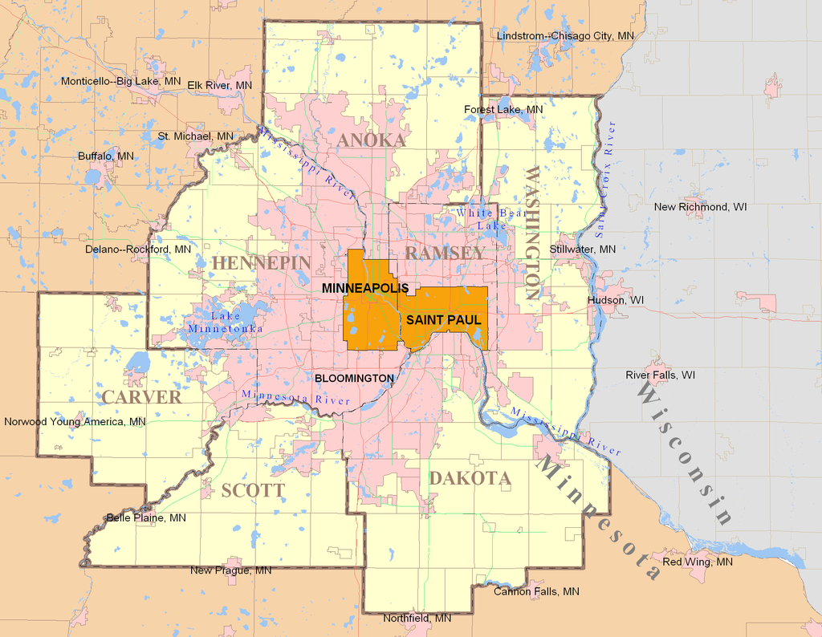
Overview
SMAC = Suburban Metro Area Continuum of Care: Carver, Scott, Dakota, Washington, and Anoka counties

Slide 3
Continuum of Care
NOT an entity!
A Collaboration
Tasked by HUD with creating a community plan to prevent and end homelessness
We are required by HUD to report our progress (via HMIS), even on projects they don’t fund!
They use this information to decide how much money they will give us
The worse we do, the less we get! >.<

Slide 4
Hearth Act Definition
Minimum requirements for this systematic approach include:
Emergency Shelters
Rapid rehousing
Transitional Housing
Permanent supportive housing
Prevention strategies
Continuum of Care programs are not sufficient to prevent and end homelessness alone
Coordination and integration of other funding streams is integral to carrying out the Continuum of Care System.

Slide 5
History
Timeline of key moments in SMAC
2009 – Formation of Scarvington & Danoka
2011- SMAC Created Merger of Scarvington & Danoka CoCs
Late 2014
By-laws adopted to shift voting and governance to SMAC
2015- Central Coordinator Position created, funded and staffed
2003-2009:
Separate CoCs by County (Scott Carver created together)
Notes:
There was a lot of planning that happened before SMAC became SMAC. I am not going to go into the nitty gritty details of how it all happened but wanted to give you a rough time line so you can understand our history.
The four regions that now make up SMAC, Scott/Carver, Anoka, Washington, and Dakota, all operated as separate CoCs from 2003 to 2009.
In 2009, as a step towards full consolidation, Scott/Carver and Washington merged (forming Scarvington) and Dakota and Anoka merged (Danoka). This step was needed to protect funding that would have been lost if all regions merged at the same time.
The merger into a 5 county CoC (SMAC) in 2011 was negotiated with a compromise in the by-laws to keep decision making at the local housing collaborative level, such as the local housing coalitions. Typically recommendations and motions for action were formulated at the SMAC level and forwarded to the local housing coalition level for approval. Changes to the SMAC by-laws and local coalition by-laws were required in order to move the decision making to the regional CoC level and meet the requirements of HEARTH.
In 2014 the decision was made to shift the voting power from the local coalition groups to the Governing Board. That is the current structure.
In 2015 the Central Coordinator position was funded.

Slide 6
NOFA
Notice of Funding Available
HUD tells each CoC every year how much $$ it can apply for
Based on last year’s performance
CoC asks for applications from programs
CoC is required to score and rank it’s own programs
If HUD gives the CoC less money than it applied for, the programs are cut in the order the CoC gave
Every year, HUD grades the CoC on it’s performance
The ONLY way to get more money is to improve performance!
Length of time homeless, returns to homelessness, increased income of participants, etc.

Slide 7
Why do we apply together?
People experiencing homelessness don’t have “residency”
Encourages more cross-county cooperation to the benefit of clients
Combines administration costs
The HUD application takes A LOT of work - made more sense to combine and pay 1 person to do most of it, rather than 4
Gives us more money
It’s easier to create full programs from a larger pot of money pooled together than 5 different smaller pots

Slide 9
SMAC Infrastructure -Paid staff
1 SMAC Coordinator (Abby)
Big picture – job is to coordinate all programs and help the Governing Board
2 CE Planners (Liz and Steve)
One primarily completes referrals to housing providers
One does more policy change work, back-up for referrals
1 CE Navigator (Robbin)
Receives referrals from CE Planner for people who need more help getting into a housing program
8-10 CE Directors
People with lived experience of homelessness to provide CE system direction

Slide 10
How does SMAC matter to me?
ALL data you enter into HMIS matters!
Even if you aren’t a HUD program!
Project Entry/Exit and updates paperwork is used to determine whether we are decreasing lengths of time homeless, increasing income, etc.
If we do well, we can increase the $$ we can apply for from HUD - like we did this year!
We need your input!
To set priorities
To determine which projects we should fund with HUD dollars

