Slide 1
Vacancy Reporting
December 2019 through November 2020
Notes:
We are looking at the whole priority pool now, no just chronic.

Slide 2
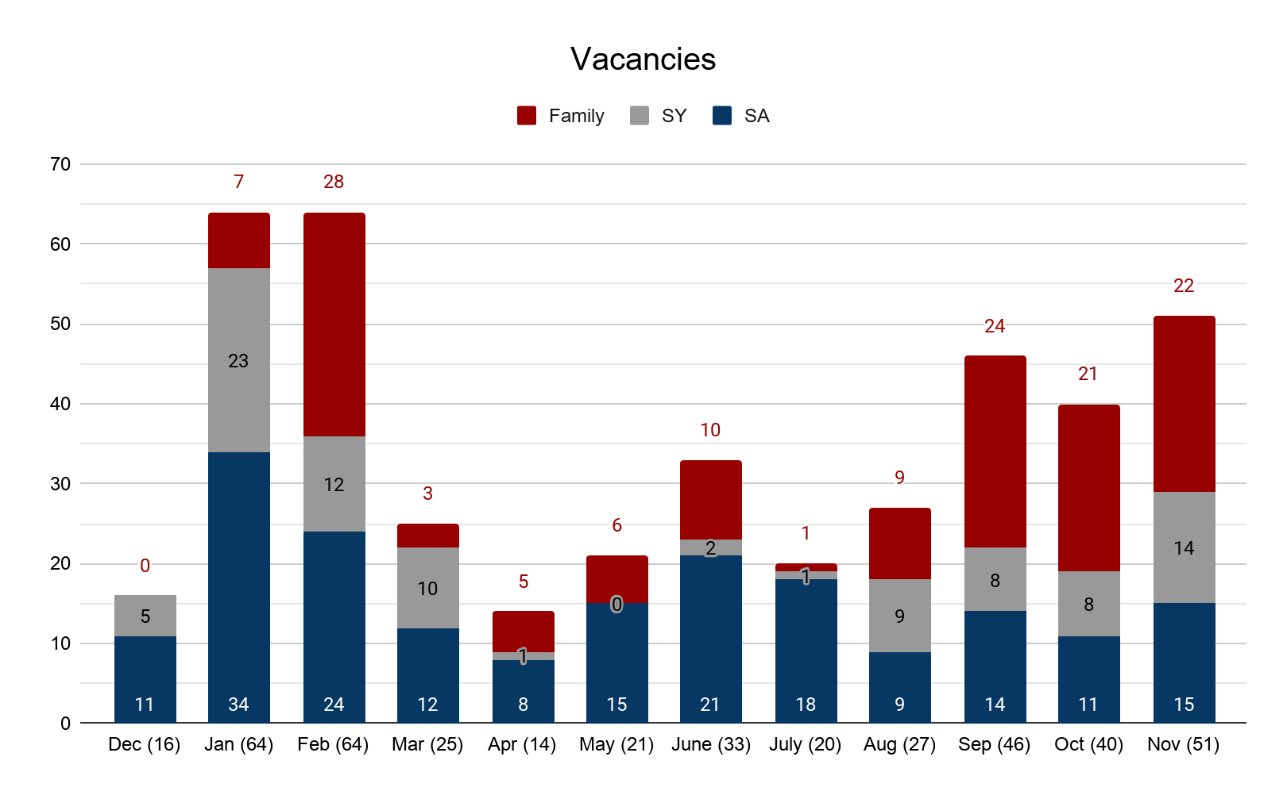
Vacancies by Household Type
Notes:
350 Households in the priority pool EOM November, 42 Families (12%), 43 Single Youth (13%), 265 Single Adults (75%)

Slide 3
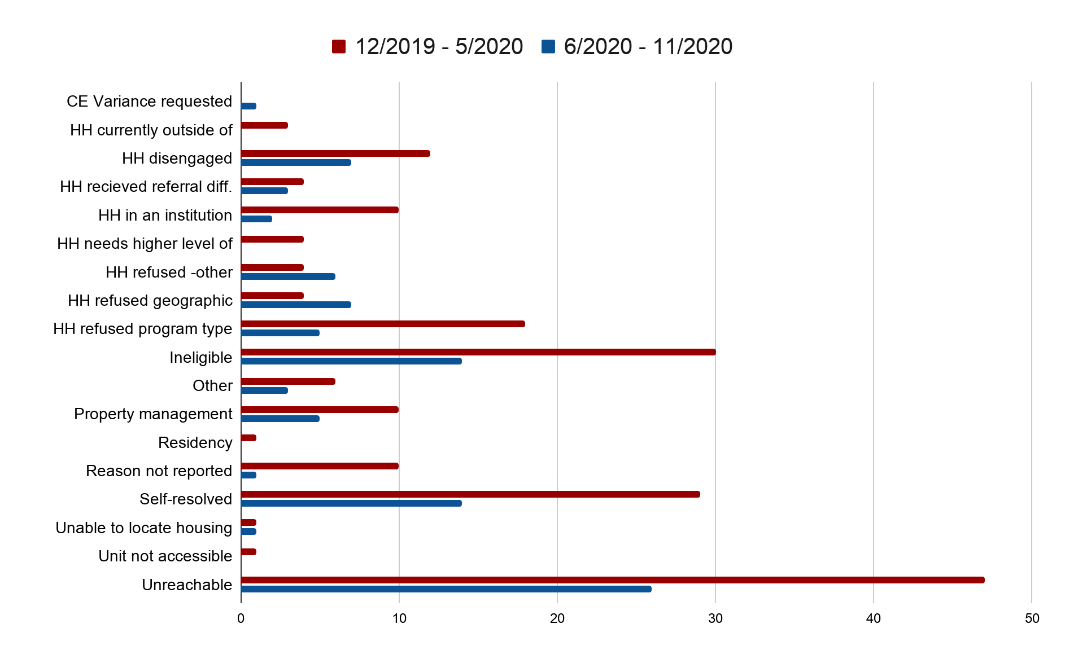
Denials by Type
Notes:
December 2019 through May 2020 - 194 total denials
June 2020 through November 2020 - 95 total denials

Slide 4
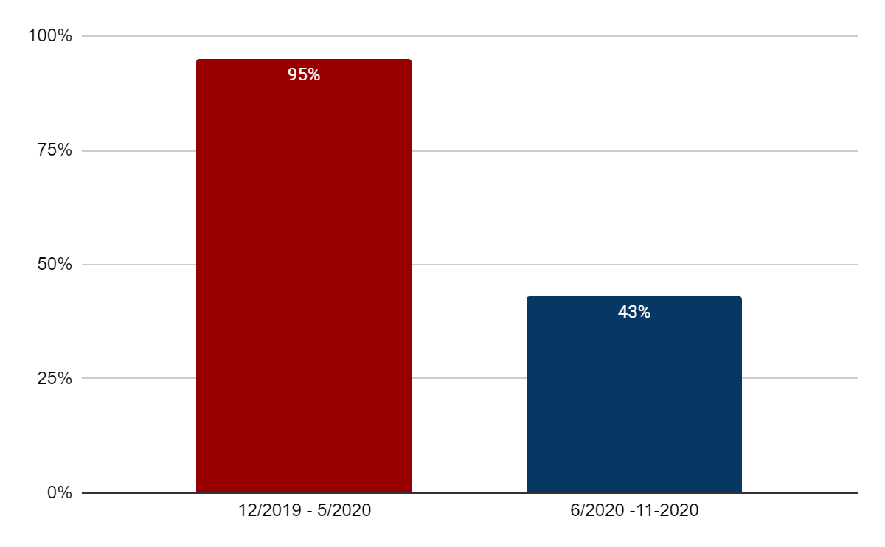
Denial Rate
Notes:
This is huge! More than cut in half
November through May SMAC had 204 reported vacancies and 194 denials
June through November SMAC had 217 reported vacancies and 95 denials

Slide 5
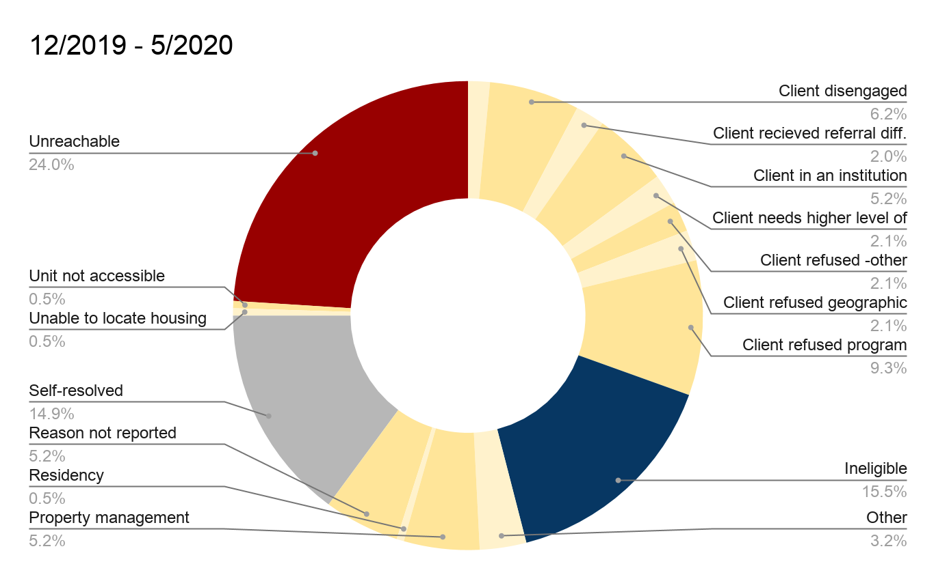
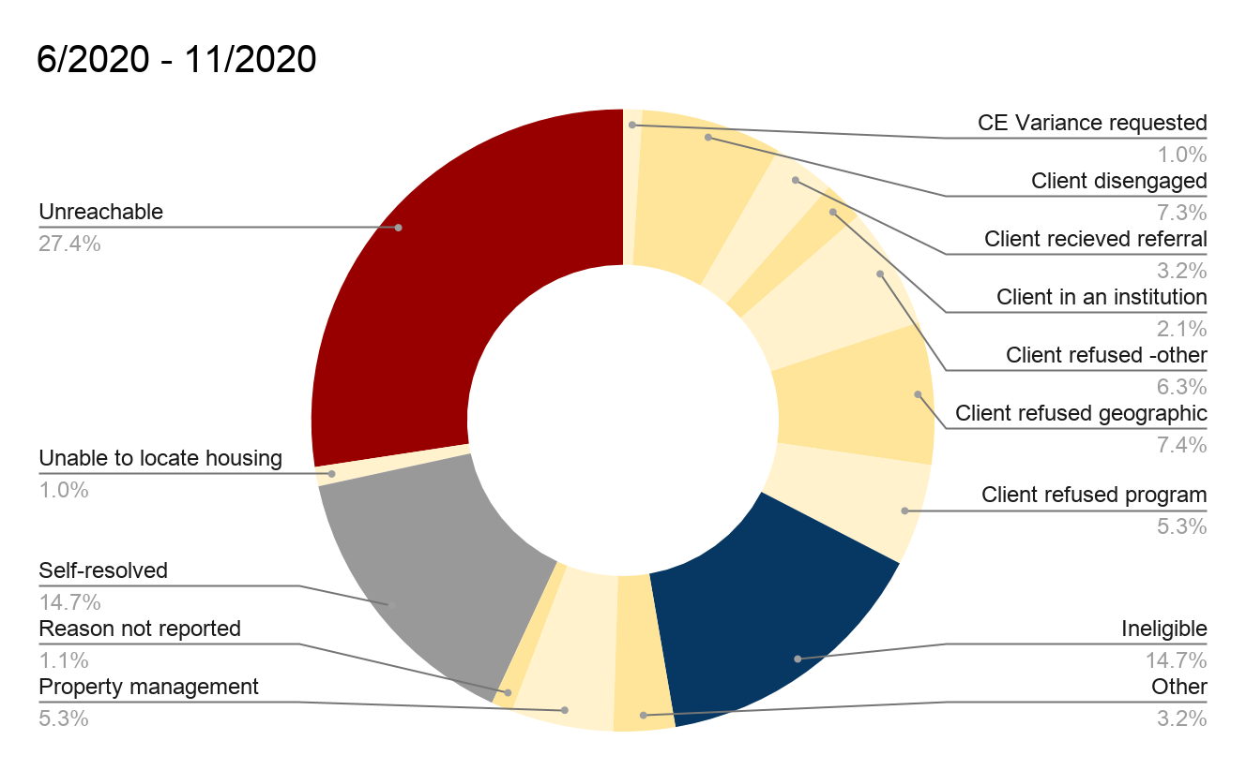
Denials for Thought
Notes:
Pay attention to the Red, Blue and Grey.

Slide 6
Chronic Families &
Chronic Youth Singles
SMAC’s numbers as of November 30, 2020
Notes:
When going through this remember that we are only looking at Chronic Households that identify as families or single youth. We are not looking at chronic single adult.

Slide 7
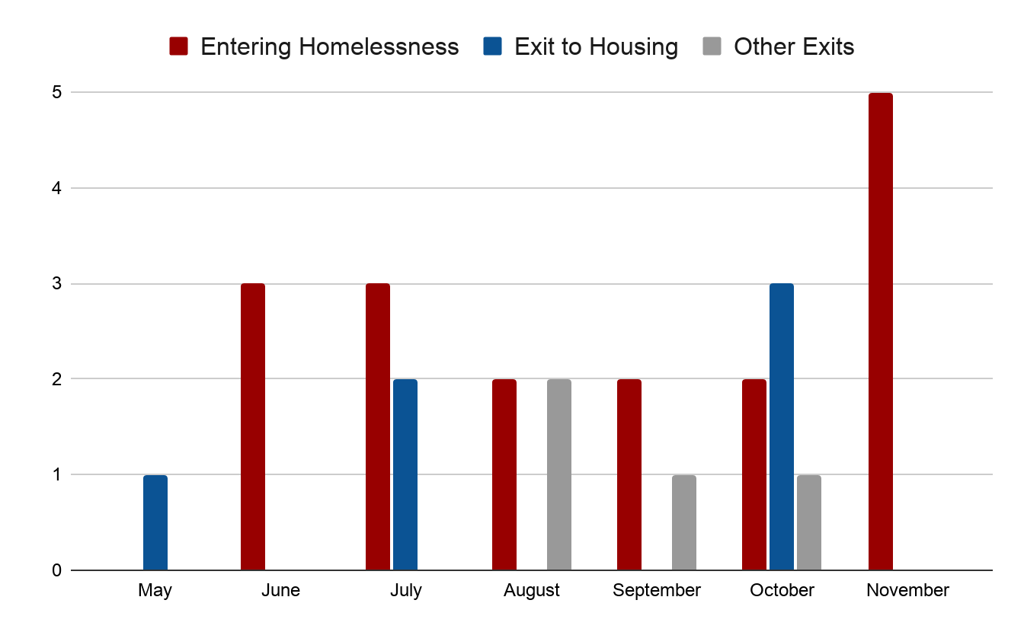
Benchmark 1 - Families
The number of chronic families entering homelessness is less than or equal to the number of chronic families exiting homelessness.

Slide 8
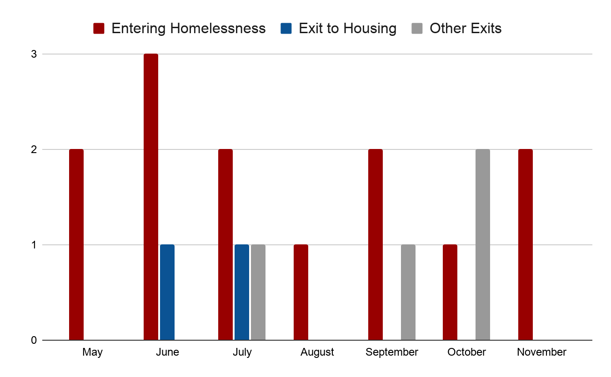
Benchmark 1 - Youth Singles
The number of chronic single youth entering homelessness is less than or equal to the number of chronic youth singles exiting homelessness.

Slide 9
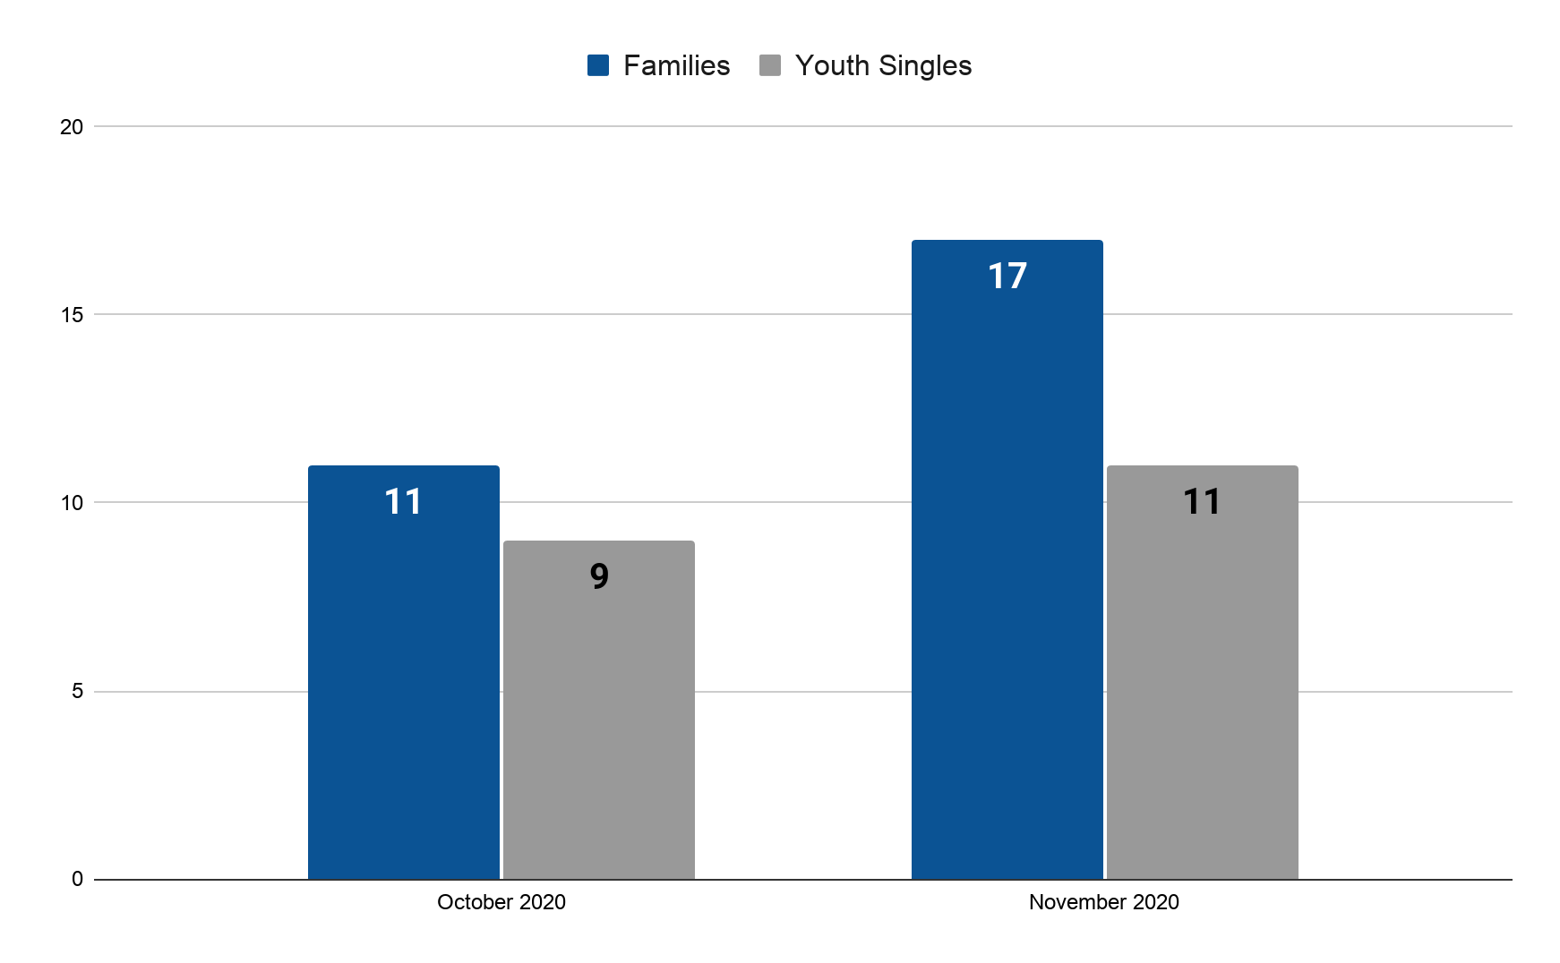
Benchmark 2 - Families and Youth Singles
The community has no households experiencing chronic homelessness.
Notes:
11 of these families have open active referrals
9 of these youth have open active referrals

Slide 10
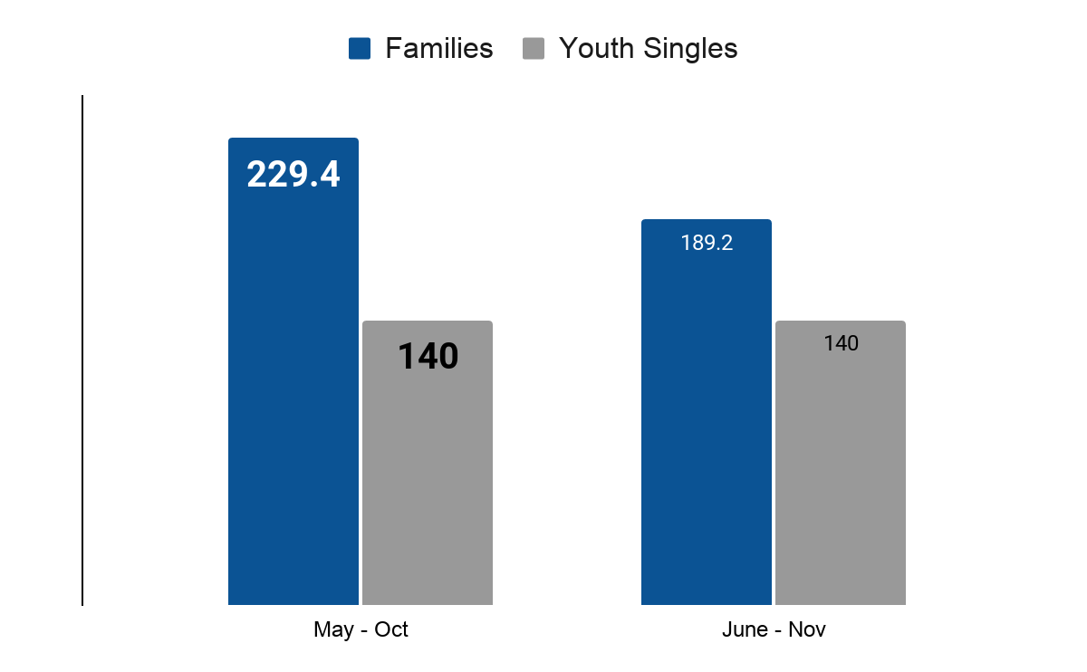
Benchmark 4 - Families and Youth singles
Chronic households have quick access to permanent housing; on average 90 days or less.

