Slide 1
Suburban Metro Area Continuum of Care’s
Coordinated Entry System
An Introduction

Slide 2
Coordinated Entry System (CES)
A process intended to streamline access and referrals to resources aimed at preventing and ending homelessness, including:
Eviction/Homelessness Prevention
“Mainstream” services/resources
Rapid Re-Housing: 3-24 months of rental assistance and case management
Permanent Supportive Housing: on-going rental assistance and case management
Always improving
Not finished until we can prevent homelessness wherever possible, and ensure when it does happen that it is rare, brief, and non-recurring.
Does not add housing – organizes existing resources

Slide 3
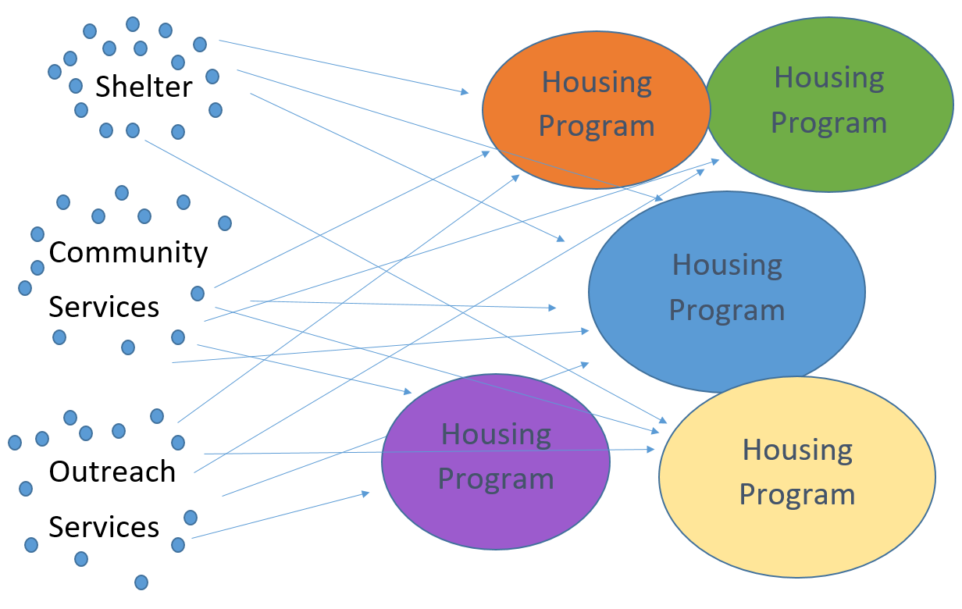
Creating a Systematic Response
Notes:
Matt/Abby

Slide 4
Who does SMAC’s CE work?
Coordinated Entry Assessors (Approx. 50)
Housing Providers (36 agencies, 66 programs)
Rapid Re-Housing/ Transitional Housing
Permanent Supportive Housing
Outreach workers
CE Planners (2)
CE Navigator (1)
Homelessness Prevention agencies
Requires lots of collaboration!

Slide 5
SMAC Coordinated Entry System (CES) History
Prior to 2014
2014
2017
2018
2020
All programs had their own waitlists or procedures for filling openings
Began implementing CES county-by-
county
CE put into HMIS – created SMAC
-wide list
Centralized CES referrals and monitoring - Streetworks and Salvation Army
Moved CES referrals to Hearth Connection and got full-time Navigator position

Slide 6
Current Coordinated Entry System (CES)
Problem-solving/Rapid Resolution attempts (Step 1)
Supportive Housing Eligibility Assessment (Step 2)
Priority Pool
Referral to Supportive Housing
In 2019, CE only had enough programs to serve approx. 50% of households entering CE each month
Notes:
This is the first time we have EVER known our capacity or our needs as a community!

Slide 7
Important!
No Supportive Housing option through Coordinated Entry is supposed to be forever!
Designed to give people the support they need to exit homelessness and maintain housing, then back away
We need to be able to serve the new folks coming in
Good to build this expectation at the outset
Section 8 and Public Housing are more permanent options
Notes:
Liz

Slide 8
Rapid Resolution (Step 1)
This is a creative problem-solving approach to ending or easing a person’s housing crisis while reducing systems trauma
The goal is to find a safe, appropriate place for someone to stay more immediately than the Priority Pool can provide
Offered at a minimum to everyone who is LTH or HUD homeless, but unlikely to be prioritized for a Supportive Housing referral
Notes:
Laura

Slide 9
Supportive Housing Eligibility Assessment (Step 2)
Long list of questions to determine eligibility for all Supportive Housing programs
Enters into Priority Pool

Slide 10
Priority Pool
Generally consists of folks who have been HUD homeless the longest
Does not have a specific “order” - it’s a pool, not a list!
Homeless-specific housing providers submit their openings, and the pool is filtered based on eligibility criteria and client preferences
Have a priority to serve folks who have been outside or in shelter the longest
Assessors are asked to follow-up with people in the Priority Pool every 90 days if they haven’t been offered housing

Slide 11
Priority Pool Housing Options
Non-CE Housing Options
All housing with a homelessness requirement
Rapid Re-Housing
Transitional Housing
Permanent Supportive Housing
CADI waiver housing
Customized Living
Affordable Housing
Section 42
Other low-rent apartments (not subsidized)
Subsidized Housing
Housing Choice Vouchers
Project-based Section 8
Public Housing
Non-LTH Housing Support
Roommates
Notes:
Laura

Slide 12
Processes
Weekly case consultations for clients in HMIS
Select those most likely to receive a referral to attempt to connect before a referral is sent
Goal is to identify all high priority households and maintain contact until they can be matched with a program
Monthly case consultations for clients not in HMIS – mostly DV shelter residents
Purpose is to problem-solve outside of CE where possible, create increased understanding of CE and DV systems, and identify highest priority households for CE referrals

Slide 13
What does this mean?
We need more housing!
Only approx. 1-2% of all rental units in the suburbs are vacant at any given time
“Healthy” rental vacancy rate is 5%
Not many options = more expensive
Until we get more housing (call your legislators!), we need to serve people better
Only do full long assessment with people who will be referred to Supportive housing
Offer other services to people who won’t

