Slide 1
RACIAL EQUITY IN COORDINATED ENTRY POLICY
OCTOBER 2020

Slide 2
WHY ARE WE HERE?
SPARC Recommendations in June
Look at all policies and procedures through a Racial Equity lens
While we continue asking questions, we need to start implementing changes NOW
Notes:
SPARC’s audience is the broader community – affecting systems the CoC doesn’t directly control. We all can and should work to dismantle broader systemic racism through collective action. In this group we need to affect change where we have control, which is Coordinated Entry policies and procedures.

Slide 3
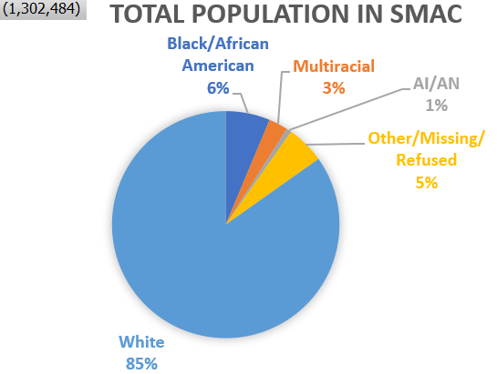
TOTAL POPULATION NUMBERS
 | Carver | Scott | Washington | Dakota | Anoka
Population estimates, July 1, 2019, (V2019) | 105,089 | 149,013 | 262,440 | 429,021 | 356,921
White | 96,892 | 125,916 | 224,124 | 358,662 | 299,100
 | 92.20% | 84.50% | 85.40% | 83.60% | 83.80%
Black or African American | 2,312 | 8,047 | 13,122 | 32,177 | 26,412
 | 2.20% | 5.40% | 5.00% | 7.50% | 7.40%
American Indian and Alaska Native | 315 | 1,639 | 1,575 | 2,574 | 3,212
 | 0.30% | 1.10% | 0.60% | 0.60% | 0.90%
Two or More Races | 1,997 | 3,725 | 6,561 | 12,871 | 10,351
 | 1.90% | 2.50% | 2.50% | 3.00% | 2.90%
Notes:
SMAC’s overall population very nearly mirrors the population breakdown for the whole State.

Slide 4
DATA NOTES
ICA (PIT) and HMIS
All the info from CE is coming from the Priority Pool in HMIS
PIT Data is Individuals and HMIS data is all Households
Notes:
The rest of the data we will be examining is coming from ICA and HMIS. All the charts talking about CE are referring to those who are in the Priority Pool. We do have access to Step 1 data, but most assessors are not yet completing Step 1s, so the data is incomplete and unhelpful right now.
The PIT data presented represents total individuals, including children, and the HMIS data is all HoH only, so they can’t exactly be directly compared.

Slide 5
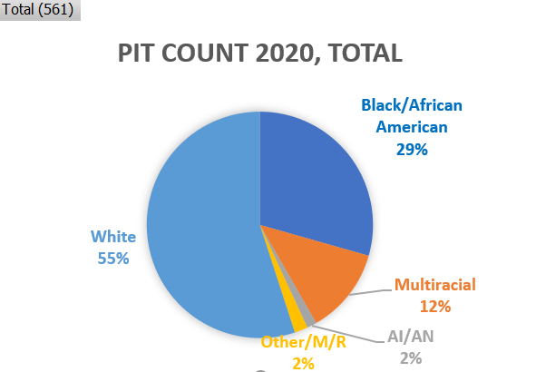
INDIVIDUALS COUNTED DURING PIT (INCLUDING CHILDREN)
PIT individuals | Total (561) | Singles (326) | Families (234 – includes children)
White | 55% | 68.7% | 36.3%
Black/African American | 29.4% | 22.4% | 40.2%
Multiracial | 12.3% | 6.1% | 20.9%
Native/Indigenous | 1.4% | 0.9% | 2.1%
Notes:
Here we see huge differences in the racial breakdown of Singles vs. Families, and this trend you will see continues across data sets.
I know the 2020 PIT numbers were just released,

Slide 6
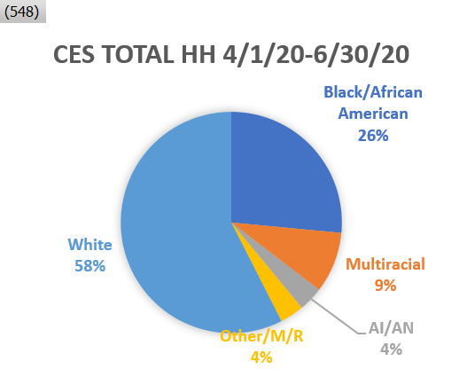
ANALYZING DATA
Notes:
The proportions of the data SPARC analyzed, the PIT Data, and the CES Priority Pool all show similar percentages.
Our goal is to make sure that our Priority Pool matches the percentages of the general homeless population, and so far that’s looking OK.

Slide 7
MENTI.COM
What surprises you about this data?

Slide 8
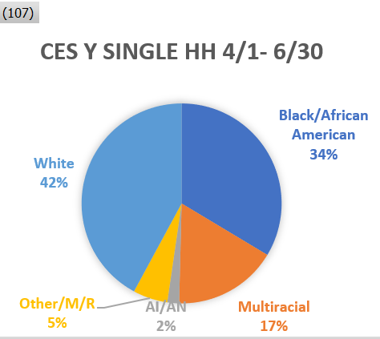
Q2 2020 SINGLES VS. YOUTH SINGLES
Notes:
Consistently through all data sets, singles are more white than families and youth, and Youth are more diverse than adults.
The only exception to this that we’ve found is with Native Youth. The percentages of youth who are Black or Multiracial are consistently higher than the general population, but the opposite is true for Native Youth.

Slide 9
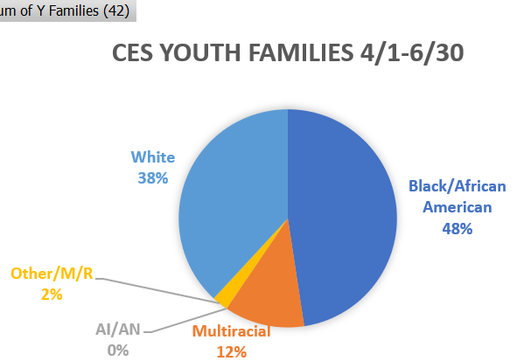
Q2 2020 FAMILIES VS. YOUTH FAMILIES
Notes:
Here again, we can see that youth families are more diverse than families in general, but we’re not finding Native Youth Families. This is a little trickier because the Youth numbers in general are lower than the overall numbers, so we can’t make any sweeping statements just yet, but it’s definitely a concern.

Slide 10
MENTI.COM
What action would you take based on this data?

Slide 11
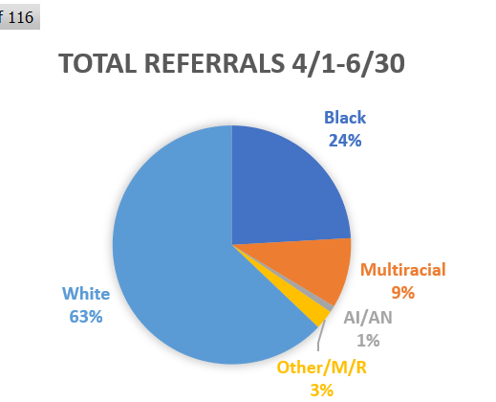
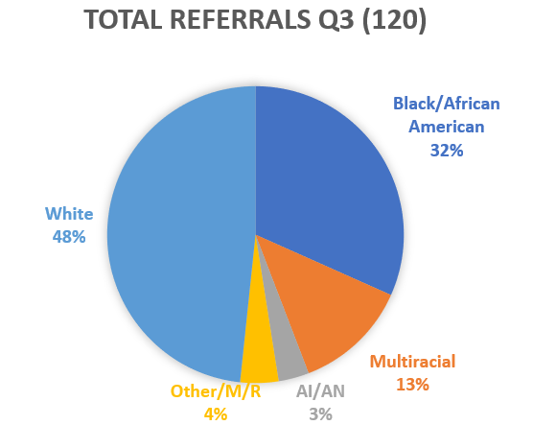
CES REFERRALS
Notes:
With the next several slides, we see some pendulum swinging from Q2 to the first part of Q3. Due again to relatively low numbers, things change a lot very quickly. We haven’t dug in enough to know if the difference is due to the types of programs that had openings (singles vs. families, for example).
It’s another thing we need to keep an eye on.

Slide 12
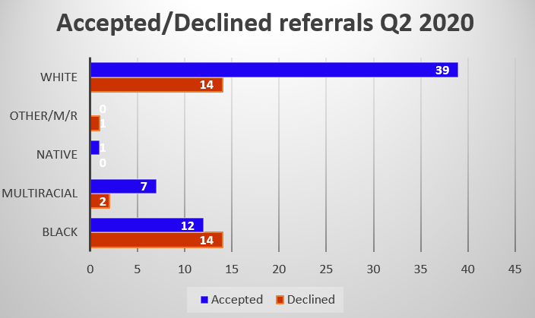
REFERRAL OUTCOMES Q2
Notes:
Here in this quarter is a very concerning pattern of white folks being far more likely to get accepted than black folks.

Slide 13
REFERRAL OUTCOMES Q3
Notes:
In Q3, the pendulum swung again.

Slide 14
MENTI.COM
What surprises you about this data?

Slide 15
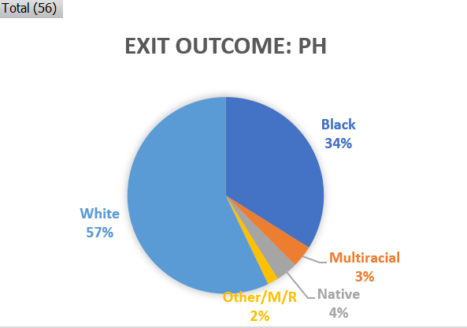
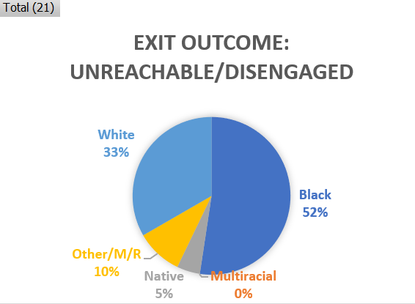
CES EXIT OUTCOMES Q2
Permanent Housing | Total (56) | Singles (36) | Families (20) | Youth (13)
White | 57.1% | 66.7% | 40% | 46.2%
Black | 33.9% | 30.6% | 40% | 30.8%
Multiracial | 3.6% | 2.8% | 0.5% | 7.7%
Native | 3.6% | 0 | 10% | 0
Notes:
When we compare where people exit from CE – in Q2 the exits to PH look pretty good, but when we look at who is unreachable/disengaged once again there is concern.

Slide 16
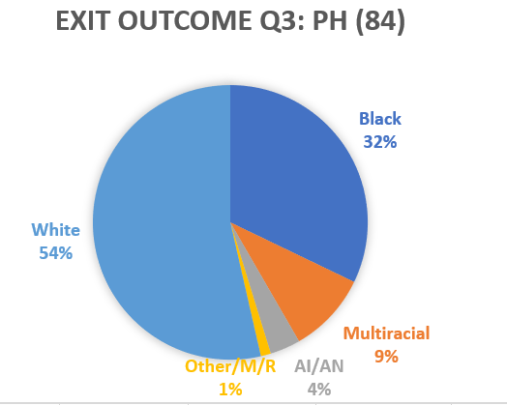
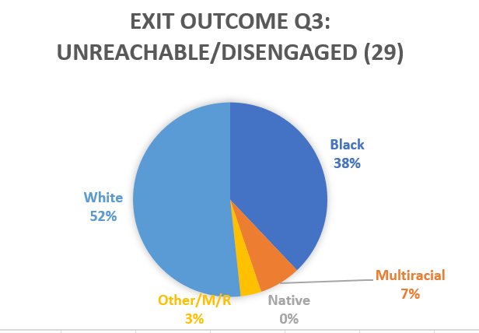
EXIT OUTCOMES: Q3
Exit Outcome: Unreachable/Disengaged | Total (9)
White | 7
Black | 1
Multiracial | 1
Native | 0
Other/M/R | 0

Slide 17
MENTI.COM
What action would you take based on this data?

Slide 18
ACTION TO TAKE
Recommendation: Prioritize Youth in the Priority Pool
Talked with several stakeholders: SPARC leader (Kelina), Directors Council, CES leadership
Recommendation: Explore ways to increase outreach to Native Youth
Recommendation: Ensure Housing Providers and Assessors are aware of disparity of folks being deemed “unreachable/disengaged,” and ensure every effort is made before exiting.

Slide 19
BREAK-OUT SESSIONS
What are your thoughts on the recommendations? What is it that we missed or overlooked?
What other trends should the CoC investigate to help impact racial disparities? For example:
Criminal history
Previous homelessness *
Previous evictions
System involvement
Notes:
Address expectations for open and honest discussion both in break-outs and in large group

