Slide 1
Dynamic Prioritization & Rapid Resolution
March 23rd, 2020

Slide 2
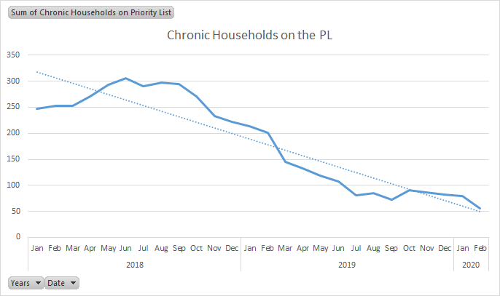
Our Progress
Notes:
56 CH households remaining!
Down from an all-time high of 306 back in June of 2018

Slide 3
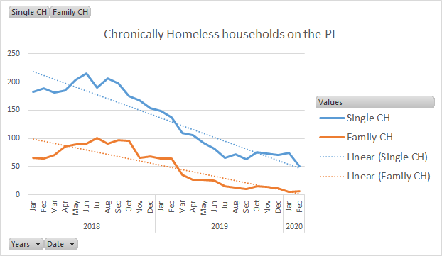
Our Progress
Notes:
Hovering around 5 CH families!
THANK YOU to providers for working with this population

Slide 4
Our Progress
Effects of list clean-up efforts
Notes:
THANK YOU to assessors for doing the work of maintaining our list!

Slide 5
Next Challenge

Slide 6
Next Challenge
Constant chase (Hamster wheel)
This is why list clean-up is never-ending!
Capacity to house approx. 50% of the people we are adding to the list
Service Opportunities
Improve service delivery to the other 50%
Find other options besides adding to a list to nowhere.

Slide 7
Dynamic Prioritization
In the Spring of 2018, HUD introduced Dynamic Prioritization as a best practice for Coordinated Entry
We have implemented parts of it over the past two years
Need to re-focus

Slide 17
Quarterly Averages 2019 Of the households entering each quarter…
 | Entering during period | Exits to TH or PH enrollment
Avg. Singles | 198.75 | 85
Avg. Families | 71.5 | 51
Avg. Youth | 82.5 | 42.5
Average HHs | 271 | 145.25

Slide 18
New CES Procedure
Step 1: Complete (In HMIS!) with everyone who is HUD homeless or LTH (or MN Youth Homeless)
Includes Problem-Solving, Rapid-Resolution attempts
IF Rapid Resolution fails, a Step 2 may be completed with anyone who is currently HUD homeless, OR is currently LTH AND has been HUD homeless in the last 90 days.
*HUD homelessness = outside, in Emergency Shelter, or fleeing/attempting to flee DV/sexual exploitation

Slide 19
Diversion/Problem-Solving/Rapid Resolution
These are all the same thing – so what is it?
A strategy to assist households in resolving their immediate housing crisis by accessing alternatives.
Occurs at the point households are presenting as homeless – either at shelter or CES Access Point
Occurs BEFORE a Step 2 is completed.
Understanding that a Step 2 will not resolve their housing crisis immediately anyway, doing this exploration with them IS a service
Most Assessors are doing some version of this already – may just need to change the timing.

Slide 20
What is Rapid Resolution?
A service to help households avoid a list to nowhere and find safe alternatives
NOT a denial or barrier to CE. It is PART of CE - where it starts.
It expands options

Slide 21
What is Rapid Resolution?
Problem-solving conversation where a household can identify, through guided strength exploration, a safe and appropriate alternative to a list to nowhere
Light touch intervention, where services are brief and geared to connect households to resources in the community

Slide 22
What is Rapid Resolution?
Services can include:
Creative problem-solving conversations to identify solutions to housing situation
Connections to family and natural supports
Strength based, short-term case management
Conflict resolution
Housing search
Landlord/tenant mediation
Connection to other resources
Financial assistance (financial assistance often times is not necessary to successfully divert)
Connection to more appropriate service system (i.e. healthcare, nursing facilities)

Slide 23
Rapid Resolution is NOT…
A Way to Turn Away From CES
Instead, providing a chance to avoid further systems trauma and find safe, appropriate alternatives
Long-term case management
Strategy to maintain clients in an unsafe situation

Slide 24
Why do Rapid Resolution?
Reduces new entries into homelessness
Keeps Priority Pool dynamic and accurate
Reduces demand for limited shelter beds and Supportive Housing
Improves system performance
Targets more intensive interventions and resources for those with higher barriers and no alternatives

Slide 25
Reminder - New Proposed CES Procedure
Step 1: Complete (In HMIS!) with everyone who is HUD homeless or LTH (or MN Youth Homeless)
Includes Problem-Solving, Rapid-Resolution attempts
IF Rapid Resolution fails, a Step 2 may be completed with anyone who is currently HUD homeless, OR is currently LTH AND has been HUD homeless in the last 90 days.
*HUD homelessness = outside, in Emergency Shelter, or fleeing/attempting to flee DV/sexual exploitation

