Slide 1
Agenda
9:00-9:30 – Registration/Breakfast
9:30 – 9:45 – Welcome, Day 1 Reflections
9:45 – 10:00 – Racial Equity Team Presentation
10:00 – Activities
Defining Core Values
Collective Vision
Short-term Priorities
Long-term Priorities
12:10 – Wrap up & next steps
12:30 - End

Slide 2
SMAC Retreat – Day 2
4.25.23

Slide 3
Land Acknowledgement
We are residing on the traditional, ancestral, and contemporary homeland of the Wahpekute Dakota people.
People who were forced off of this land, and people who were forced onto this land are negatively affected by housing systems at much higher rates than whites.
Far too often decisions are being made for Black, Brown, Indigenous People of Color without their input or their voices being heard or considered.
It is our challenge today and always to disrupt these patterns and build our way to Racial Equity.
https://native-land.ca/ - Find out whose land you’re on
https://washmn.org/news/what-does-it-mean-to-support-land-back-initiatives-in-minnesota/ - We Are Still Here MN
https://iltf.org/special-initiatives/land-recovery/ - Indian Land Tenure Foundation

Slide 4
Agenda
9:00-9:30 – Registration/Breakfast
9:30 – 9:45 – Welcome, Day 1 Reflections
9:45 – 10:00 – Racial Equity Team Presentation
10:00 – Activities
Defining Core Values
Collective Vision
Short-term Priorities
Long-term Priorities
12:10 – Wrap up & next steps
12:30 - End

Slide 5
Meet the facilitator
Victoria McWane-Creek is 2021 Facing Race Award Honoree, 2020 Minnesota Women's Press Changemaker, founder of Organization 4 Full Participation, and a performance improvement specialist. She is also an Art of Hosting practitioner, a Baldrige Performance Excellence evaluator, Respectful Conversations facilitator, an Implications Wheel practitioner, a Certified Diamond Inclusiveness Assessment facilitator, and a Qualified Administrator for the Intercultural Development Inventory.

Slide 6
Day 1 Reflections

Slide 7
SMAC Racial Equity Team
Presenters:
Ranee Rock, Directors Council
Kamaria Toulon, Governing Board
Notes:
Ranee

Slide 8
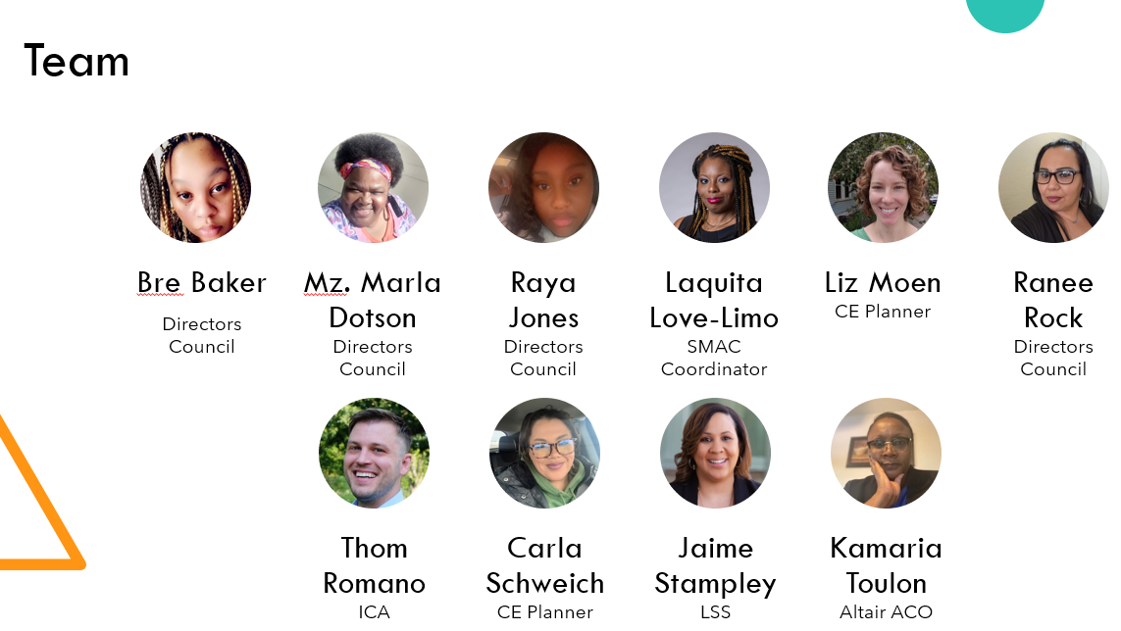

Slide 9
Change takes time and effort
SMAC participates in SPARC (Supportive Partnerships for Anti-Racist Communities)
2019
June 2020
Sept. 2020
Dec. 2020
Feb. 2020
2021
2022
Notes:
Kamaria
This timeline demonstrates both that our community has the skills and motivation to change, and to be transparent that structural change takes a long time

Slide 10
Supportive Partnerships for Anti-Racist Communities
Group met once/month
Tried to bridge racial divide as it relates to housing
C4 Innovations provided Technical Assistance
Notes:
Kamaria

Slide 11
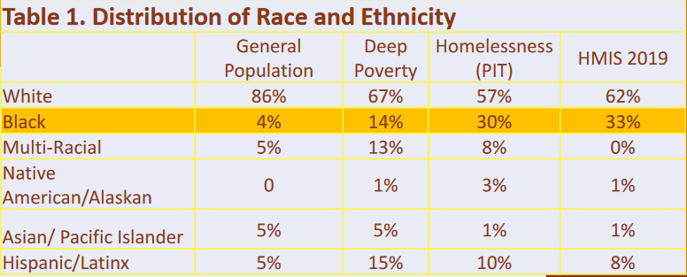
SPARC Initiative: Findings, takeaways, lessons
What it really means:
A disproportionate number of African Americans in the SMAC area are experiencing homelessness, AND this is not due to being in deep poverty.
Notes:
Kamaria

Slide 12
SPARC Initiative: Findings, takeaways, lessons
Recommended strategies to Address Racial Inequities in the Homelessness System:
Diversify voting members on the SMAC governing board and every committee with in the CoC. Encourage providers to diversify staff
Evaluate all future changes, proposals, and outcomes through Racial Equity Lens
Include people of color with lived experience in all data-related activities
Explore opportunities in policy and practice to remove “color-blind” approaches to service delivery to target persons of color experiencing homelessness
Create opportunities for including people with lived experience in decision-making processes
See full list of research and recommendations at smacmn.org/initiatives
Notes:
Kamaria

Slide 13
Change takes time and effort
2019
June 2020
SPARC Committee Presents findings to Governing Board
Sept. 2020
Dec. 2020
Feb. 2020
Directors Council first meeting
Governing Board votes to change power structure
2021
2022
SMAC participates in HUD Racial Equity Initiative
SMAC participates in SPARC (Supportive Partnerships for Anti-Racist Communities)
Directors Council makes recommendation to change CE prioritization
New Governing Board – includes Directors and majority BIPOC
Notes:
Kamaria
This timeline demonstrates both that our community has the skills and motivation to change, and to be transparent that structural change takes a long time

Slide 14
HUD Racial Equity Initiative
Core Team included several Directors Council members, Governing Board members, SMAC staff, service providers, and ICA staff
Focused on nurturing relationships, centering people with lived experience, and building a culture where everyone’s different expertise is valued
Notes:
Ranee

Slide 15
SMAC Racial Equity Core Team Findings
HUD Equity Initiative language was not accessible – re-worked according to SMAC Core Team comments
Re-affirmed disparities SPARC found among Black/African American Households
Native folks often overlooked due to small numbers, but are very overrepresented in homelessness
Property management denials are preventing progress in housing more people of color
Criminal history screening is a huge disparity issue that the CoC has not dealt with
“Core Team” needs to be formalized committee → SMAC Racial Equity Team
Notes:
Ranee

Slide 16
HUD Racial Equity Initiative: Lessons
Creating the conditions for everyone to fully contribute takes intentional effort and lots of time
SMAC Racial Equity Team has gained expertise in creating those conditions
Notes:
Ranee

Slide 17
Who’s ready?
SMAC Racial Equity Team is currently researching exactly how to improve housing outcomes for people of color with barriers like conviction/eviction records
To join, fill out sign-up sheet
To find out more information: liz@mesh-mn.org

Slide 18
Questions?

Slide 19
Defining Core Values
Identify, by name, three people over the age of 18 that have made a positive impact on your life. You must know them, and they must know you.
For each person, list 5-7 attributes that you most admire about them.
List 3-5 values that apply to all three of these people.
Notes:
Worksheet: https://drive.google.com/file/d/1rSvLywBGFKsZ3MXlGGIm5IyyUI5Y2zWm/view?usp=sharing
These are your core values…do they resonate with you?

Slide 20
Some Values
Honesty
Integrity
Wisdom
Autonomy
Loyalty
Abundance
Kindness
Charity
Respect
Courage
Generosity
Gratitude
Openness
Accountability
Compassion
Success
Self-love
Spirituality
Justice
Forgiveness
Caring
Faith
Beauty
Spirituality
Wealth
Beauty
Acceptance
Humor
Intuition
Prosperity
Change
Gracefulness
Peacefulness
Harmony
Balance
Joy
Fun
Independence
Efficiency
Promise-keeping
Fairness
Sincerity
Accuracy
Goodness
Hope
Honor
Humility
Insightfulness
Influence
Decisiveness
Knowledge
Lawfulness
Teamwork
Calmness
Bliss
Equity
Clarity
Cleanliness
Boldness
Reciprocity
Optimism
Bravery
Client Satisfaction
Friendliness
Clear Communication
Selflessness
Connectedness
Appreciation

Slide 21
Imagine
What would our system look like?
What would Black, Brown, Indigenous, People of Color people accessing services say about our system and their experience in it?
What are the values or principles that guide our system?
What changes in SMAC’s bylaws, policies, practices, or procedures must be made to make this vision reality?
SMAC has everything it needs to end racial disparities in its homelessness response system.

Slide 22
Breath Work
https://www.youtube.com/watch?v=nFkD6ByQQ1M

Slide 23
Survey!
https://forms.gle/MR1mguGB4eHJtET3A
Tell us how we did, and how often you want to get together in the future!

Slide 24
Thank you!
All slides will be provided on the SMAC Website
www.smacmn.org

